Slide 1


NEWS-LITE ~ real-time news on the go
NIT JAMSHEDPUR
[6th Semester minor project]

Slide 2
APP FUNCTIONALITIES
PRECISE NEWS
NEWS IN REALTIME
POWERED BY API
POWERED BY MVVM
DYNAMIC
APP ARCHITECTURE
SPECIAL FEATURES
SAVE ARTICLES ON THE GO
SHARE NEWS ON SOCIAL MEDIA

Slide 3
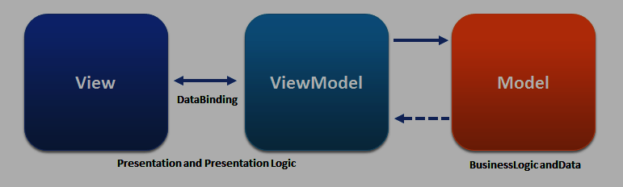
PROJECT SETUP
MODEL-VIEW-VIEWMODEL ARCHITECTURE
(MVVM)

Slide 4
Components of MVVM pattern
MODEL
VIEW
VIEW MODEL
BINDER

Slide 5


News-lite
Written in Kotlin
Retrofit for networking
Glide for loading images
Room for data persistence
Hilt for Dependence Injection
Coroutines for concurrency and async task

Slide 6

RETROFIT SETUP
Type-safe REST client for Android, Java and Kotlin developed by Square.
Retrieve and upload JSON (or other structured data).

Slide 7

GLIDE image
Image Loader Library for Android developed by bumptech.
Image manipulation library written in PHP.
Its straightforward API is exposed via HTTP.

Slide 8

DATABASE AND ROOM TYPECONVERTER
Data persistence library.
Easier to work with SQLiteDatabase objects in the app.
Decreases the amount of boilerplate code and verifies SQL queries at compile time.

Slide 9
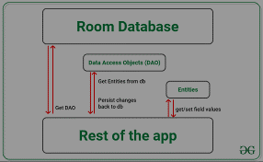
DATABASE AND ROOM TYPECONVERTER

Slide 10
DEPENDENCY INJECTION (di) with hilt
Reduces the boilerplate of doing manual dependency injection in the project.
The goals of Hilt are:-
To simplify Dagger-related infrastructure for Android apps.
To create a standard set of components and scopes to ease setup, readability/understanding, and code sharing between apps.

Slide 11
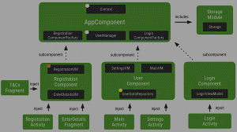
DEPENDENCY INJECTION (di) with hilt

Slide 12
coroutines
Concurrency design pattern that are used on Android to simplify code that executes asynchronously.
Asynchronous - code that runs parallel to others
(It is also called non-blocking since it does not block the main thread).

Slide 13
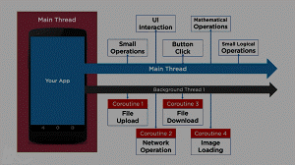
coroutines

Slide 14
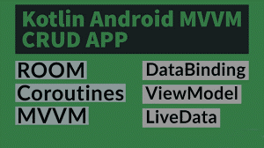
Application summary

